Slide 1

CSCE 120/121 Introduction to Program Design & Concepts
Building Objects from Classes
Dr. Tim McGuire
Grateful acknowledgment to Dr. Philip Ritchey and Dr. Michael Moore for some of the material on which these slides are based.

Slide 2
You don’t understand. I coulda had class.
— Marlon Brando’s character in On the Waterfront, 1954

Slide 3
Procedural and Object-Oriented Programming
Procedural programming focuses on the process/actions that occur in a program
Object-Oriented programming is based on the data and the functions that operate on it. Objects are instances of abstract data types that represent the data and its functions

Slide 4
Object-Oriented Programming Terminology
class: like a struct (allows bundling of related variables), but variables and functions in the class can have different properties than in a struct
object: an instance of a class, in the same way that a variable can be an instance of a struct

Slide 5
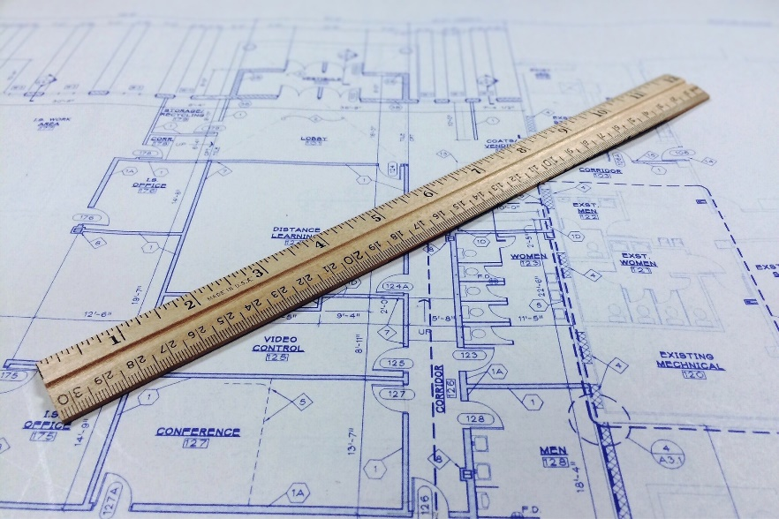



Concept of Class
Class is a generic description
Think blueprint
Object is an instance of the class
Think the blue house on the corner
And the red one on the next block
And the green one next door
I.e. there are multiple instances of a single class
a class is a template for defining objects

Slide 6
Object-Oriented Programming Terminology
attributes: members of a class
methods or behaviors: member functions of a class

Slide 7
Visibility
data hiding: restricting access to certain members of an object
public interface: members of an object that are available outside of the object. This allows the object to provide access to some data and functions without sharing its internal details and design, and provides some protection from data corruption

Slide 8
Introduction to Classes
Objects are created from a class
Format:
class ClassName
{
declaration;
declaration;
};

Slide 9
Class Example
class Rectangle
{
private:
double width;
double length;
public:
void setWidth(double);
void setLength(double);
double getWidth() const;
double getLength() const;
double getArea() const;
};

Slide 10
Access Specifiers
Used to control access to members of the class
public: can be accessed by functions outside of the class
private: can only be called by or accessed by functions that are members of the class

Slide 11
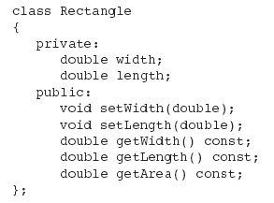
Class Example
Private Members
Public Members

Slide 12
More on Access Specifiers
Can be listed in any order in a class
Can appear multiple times in a class
If not specified, the default is private

Slide 13
Using const With Member Functions
const appearing after the parentheses in a member function declaration specifies that the function will not change any data in the calling object.
double getWidth() const;
double getLength() const;
double getArea() const;

Slide 14
Defining a Member Function
When defining a member function:
Put prototype in class declaration
Define function using class name and scope resolution operator (::)
void Rectangle::setWidth(double w)
{
width = w;
}

Slide 15
Accessors and Mutators
Mutator: a member function that stores a value in a private member variable, or changes its value in some way
Accessor: function that retrieves a value from a private member variable. Accessors do not change an object's data, so they should be marked const.

Slide 16
Defining an Instance of a Class
An object is an instance of a class
Defined like structure variables:
Rectangle r;
Access members using dot operator:
r.setWidth(5.2);
cout << r.getWidth();
Compiler error if attempt to access private member using dot operator

Slide 17
See rectangle0.cpp in Classes-Objects folder

Slide 18
Avoiding Stale Data
Some data is the result of a calculation.
In the Rectangle class the area of a rectangle is calculated.
length x width
If we were to use an area variable here in the Rectangle class, its value would be dependent on the length and the width.
If we change length or width without updating area, then area would become stale.
To avoid stale data, it is best to calculate the value of that data within a member function rather than store it in a variable.

Slide 19
Pointer to an Object
Can define a pointer to an object:
Rectangle *rPtr = nullptr;
Can access public members via pointer:
rPtr = &otherRectangle;
rPtr->setLength(12.5);
cout << rPtr->getLength() << endl;

Slide 20
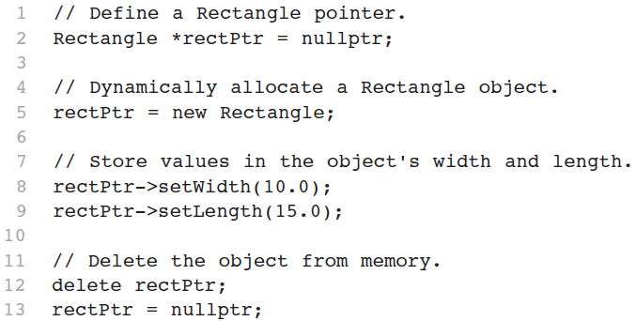
Dynamically Allocating an Object
We can also use a pointer to dynamically allocate an object.
See RectanglePtr.cpp

Slide 21
Why Have Private Members?
Making data members private provides data protection
Data can be accessed only through public functions
Public functions define the class’s public interface

Slide 22
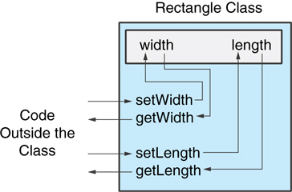
Code outside the class must use the class's public member functions to interact with the object.
Image source: Tony Gaddis, Starting out with Java

Slide 23
Separating Specification from Implementation
Place class declaration in a header file that serves as the class specification file. Name the file ClassName.h, for example, Rectangle.h
Place member function definitions in ClassName.cpp, for example, Rectangle.cpp File should #include the class specification file
Programs that use the class must #include the class specification file, and be compiled and linked with the member function definitions

Slide 24
See Rectangle Version 1

Slide 25
Inline Member Functions
Member functions can be defined
inline: in class declaration
after the class declaration
Inline appropriate for short function bodies:
int getWidth() const { return width; }

Slide 26
Rectangle Class with Inline Member Functions
See Rectangle Version 2

Slide 27
Tradeoffs – Inline vs. Regular Member Functions
Regular functions – when called, compiler stores return address of call, allocates memory for local variables, etc.
Code for an inline function is copied into program in place of call – larger executable program, but no function call overhead, hence faster execution

Slide 28
Class Constructors

Slide 29
Constructors
Member function that is automatically called when an object is created
Purpose is to construct an object
Constructor function name is class name
Has no return type

Slide 30
Constructors
See Rectangle Version 3

Slide 31
Default Constructors
A default constructor is a constructor that takes no arguments.
If you write a class with no constructor at all, C++ will write a default constructor for you, one that does nothing.
A simple instantiation of a class (with no arguments) calls the default constructor:
Rectangle r;

Slide 32
In-Place Initialization
If you are using C++11 or later, you can initialize a member variable in its declaration statement, just as you can with a regular variable. However, sometimes initializations are more complicated, in which case a constructor is needed.
This is known as in-place initialization. Here is an example:
class Rectangle
{
private:
double width = 1.0;
double length = 1.0;
public:
Public member functions appear here…
};

Slide 33
Passing Arguments to Constructors
To create a constructor that takes arguments:
indicate parameters in prototype: Rectangle(double, double);
Use parameters in the definition: Rectangle::Rectangle(double w, double len) { width = w; length = len; }

Slide 34
Passing Arguments to Constructors
You can pass arguments to the constructor when you create an object:
Rectangle r(10, 5);

Slide 35
More About Default Constructors
If all of a constructor's parameters have default arguments, then it is a default constructor. For example:
Rectangle(double = 0, double = 0);
Creating an object and passing no arguments will cause this constructor to execute: Rectangle r;

Slide 36
Classes with No Default Constructor
When all of a class's constructors require arguments, then the class has NO default constructor.
When this is the case, you must pass the required arguments to the constructor when creating an object.

Slide 37
Overloading Constructors
A class can have more than one constructor
Overloaded constructors in a class must have different parameter lists:
Rectangle(); Rectangle(double);
Rectangle(double, double);

Slide 38
Constructor Delegation
class Rectangle { … // Constructor #1 (default) Rectangle() : Rectangle(1.0, 1.0) { }
// Constructor #1 Rectangle(double w, double len) { width = w; length = len;
}
Sometimes a class will have multiple constructors that perform a similar set of steps.
In C++17, it is possible for one constructor to call another constructor in the same class.
This is known as constructor delegation.
For example, look at the following version of the Rectangle class:

Slide 39
Using Private Member Functions
A private member function can only be called by another member function
It is used for internal processing by the class, not for use outside of the class

Slide 40
Arrays of Objects
Objects can be the elements of an array:
Rectangle box[40];
The default constructor for the object is used when array is defined

Slide 41
Accessing Objects in an Array
Objects in an array are referenced using subscripts
Member functions are referenced using dot notation:
box[2].setWidth(5.0);
box[2].setLength(10.0);
cout << box[2].getArea();

Slide 42

UML Diagrams
Image source: https://www.modernanalyst.com/

Slide 43
The Unified Modeling Language
UML stands for Unified Modeling Language.
The UML provides a set of standard diagrams for graphically depicting object-oriented systems

Slide 44
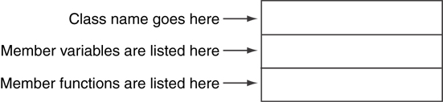
UML Class Diagram
A UML diagram for a class has three main sections.

Slide 45
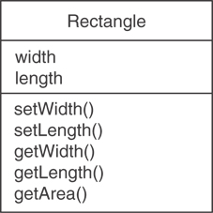
Example: A Rectangle Class
class Rectangle
{
private:
double width;
double length;
public:
bool setWidth(double);
bool setLength(double);
double getWidth() const;
double getLength() const;
double getArea() const;
};

Slide 46
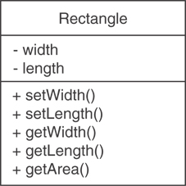
UML Access Specification Notation
In UML you indicate a private member with a minus (-) and a public member with a plus(+).
These member variables are private.
These member functions are public.

Slide 47
UML Data Type Notation
To indicate the data type of a member variable, place a colon followed by the name of the data type after the name of the variable.
- width : double
- length : double

Slide 48
UML Parameter Type Notation
To indicate the data type of a function’s parameter variable, place a colon followed by the name of the data type after the name of the variable.
+ setWidth(w : double)

Slide 49
UML Function Return Type Notation
To indicate the data type of a function’s return value, place a colon followed by the name of the data type after the function’s parameter list.
+ setWidth(w : double) : void

